Slide 1

ITIL® 4 Foundation Certification Course
Lesson 0: Course Overview
Based on AXELOS ITIL® material.
ITIL® is a [registered] trade mark of AXELOS Limited.

Slide 2


About ITIL®
ITIL® is a widely accepted best practice framework in IT Service Management (ITSM).
It is adopted by a majority of world’s organizations and professionals as a tool to facilitate business transformation and growth.

Slide 3
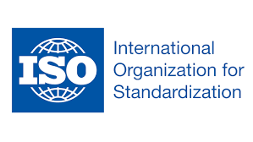
About ITIL®
ITIL is mapped in ISO 20000 Part 11.
It recognizes the way ITIL can be used to meet the requirements set for
ISO 20000 certification.
This is the first such mapping that ISO has allowed to be part of its standards.

Slide 4

ITIL® Certification
The ITSM best practice set by ITIL is supported by a certification scheme.
It enables ITIL practitioners to demonstrate their abilities in adopting
and adapting the framework to address their specific needs.

Slide 5
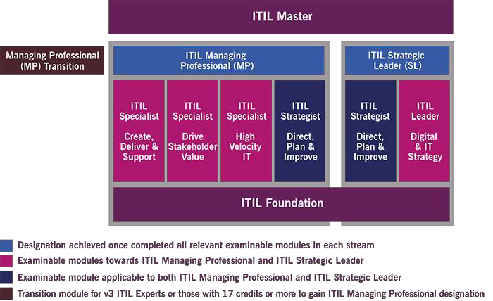
ITIL® Certification

Slide 6
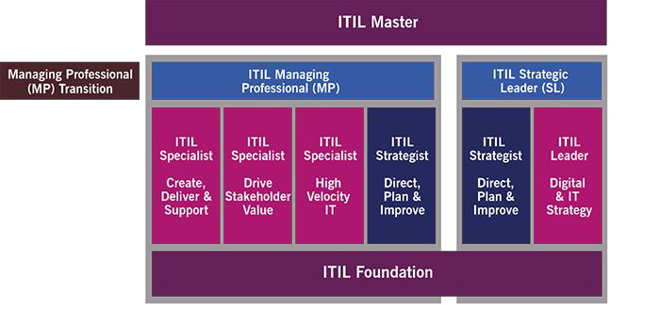
ITIL® Certification
The ITIL certification scheme provides a modular approach to the ITIL framework.
It is comprised of a series of certifications focused on different aspects of ITIL best practices to various degrees of depth and detail.
There are five certification levels within the scheme: foundation, practitioner, intermediate, expert,
and master.

Slide 7
ITIL® Foundation Certification
ITIL Foundation is an entry level certification.
It ensures general awareness of the key elements, concepts, and terminologies used in the ITIL service lifecycle.
It covers information on lifecycle stages, the processes used, and their contribution to service management practices.

Slide 8

ITIL® 4 Foundation Certification
Introduces readers to the management of modern IT enabled services
Provides learners an understanding of ITIL 4 service management framework
4
Provides professionals an understanding of the common language and key concepts
Explains the evolution of service management through adoption of modern technologies
Shows professionals how to utilize ITIL 4 guidance to improve their and their organization’s work

Slide 9
Learning Objectives of ITIL® 4 Foundation
Service management as a practice
Selected processes, functions, and roles
ITIL service lifecycle
4
Generic concepts and definitions
Technology and architecture
Key principles and models
Competence and training

Slide 10
Who Is This Certification For?
ITIL 4 Foundation certification can help:
Those who require a basic understanding of the ITIL framework
Those who want to understand how ITIL can be used to enhance IT service management
IT professionals or others working within an organization that has adopted ITIL
Professionals with ITIL certification wishing to update their knowledge
Individuals beginning their journey in service management
Individuals working in other parts of IT like digital, product, and development with a strong interface with service delivery
Existing and aspiring ITSM Managers
4

Slide 11
Course Agenda
Unit 1
Introduction to Service Management and ITIL
Unit 2
Key Concepts of Service Management
Unit 3
Four Dimensions of Service Management
Unit 4
ITIL Service Value System
Unit 5
ITIL Management Practices
Unit 6
ITIL 4 Foundation Examination Format

Slide 12
Course Agenda
Unit 1
Introduction to Service Management and ITIL
IT service management in the modern world
About ITIL 4
The structure and benefits of the ITIL 4 framework
The ITIL SVS
The four dimensions model

Slide 13
Course Agenda
Unit 2
Key Concepts of Service Management
Value and value creation
Organizations, service providers, service consumers, and other stakeholders
Products and services
Service relationships
Value or outcomes, costs, and risks

Slide 14
Course Agenda
Unit 3
Four Dimensions of Service Management
Organizations and people
Information and technology
Partners and suppliers
Value streams and processes
External factors

Slide 15
Course Agenda
Unit 4
ITIL Service Value System
Service value system overview
Opportunity, demand, and value
ITIL guiding principles
Governance
Service value chain
Continual improvement
Practices

Slide 16
Course Agenda
Unit 5
ITIL Management Practices
General management practices
Service management practices
Technical management practices

Slide 17
Course Agenda
Unit 6
ITIL 4 Foundation Examination Format
Assessment criteria
Examination administration
Question types
Scoring
Weightings by Bloom’s level
Weightings by learning outcome

Slide 18
Learning Outcomes
Understand the key service concepts
Understand how the ITIL guiding principles can help an organization adopt and adapt service management
Understand the four dimensions of service management
Understand the purpose and components of the ITIL service value system
Understand the activities of the service value chain and how
they interconnect
Know the purpose and key terms of 15 ITIL practices
Understand 7 ITIL practices

Slide 19
Let’s Begin!
Unit 1
Introduction to Service Management and ITIL
Unit 2
Key Concepts of Service Management
Unit 3
Four Dimensions of Service Management
Unit 4
ITIL Service Value System
Unit 5
ITIL Management Practices
Unit 6
ITIL 4 Foundation Examination Format

Slide 20
Thank You
ITIL® 4 Foundation Certification Course
Based on AXELOS ITIL® material.
ITIL® is a [registered] trade mark of AXELOS Limited.

